Slide 1
Cybersecurity Project
(Week 13)
Presented By:
Dennis Ng Han Jie (204461H)
Joseph (200790F)
Tan Nguet Sen Jared (200463Z)

Slide 2
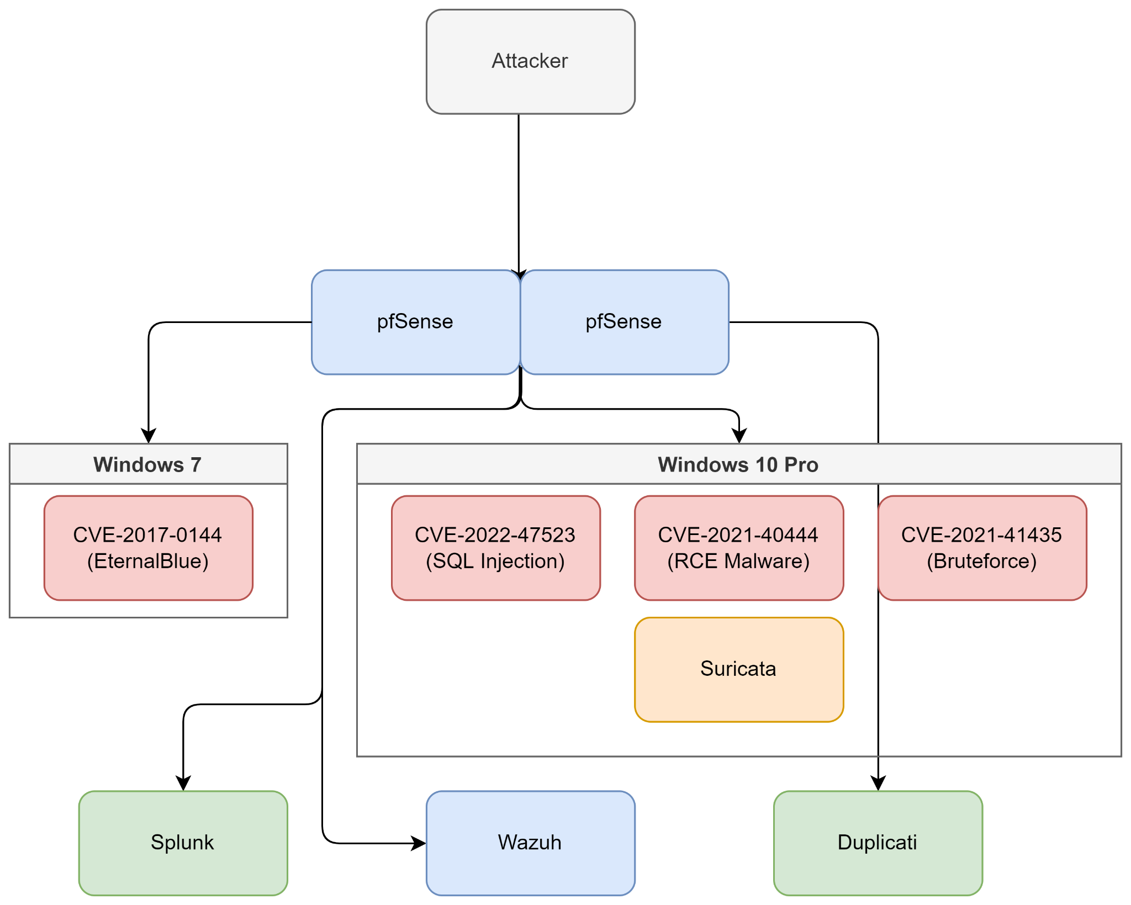

Slide 3
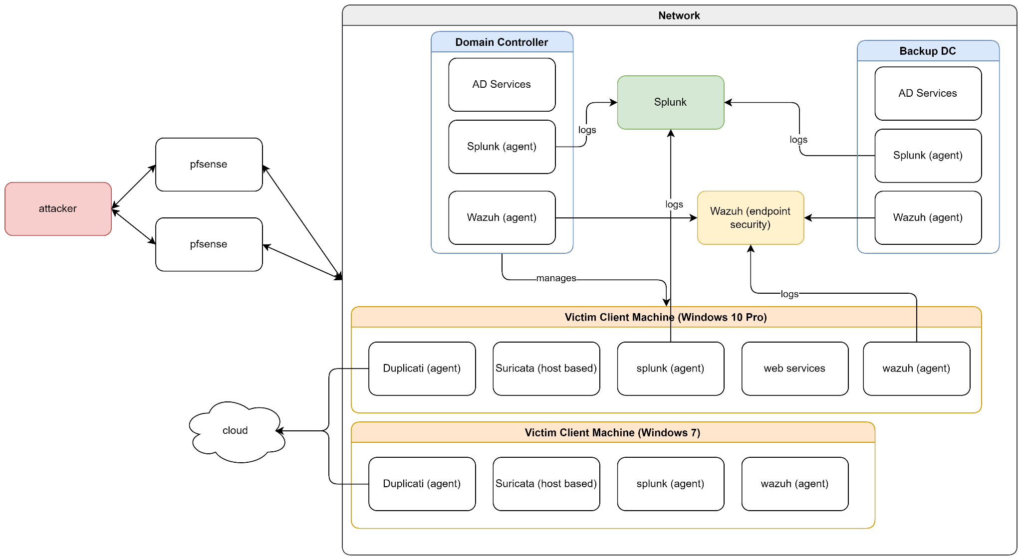

Slide 4

Best Practices for Wazuh
Dedicated server for Wazuh to prevent overloading
Send alerts that are level 12 and over to email
Create custom rules to generate alerts and decoders to read the logs generated from custom active response programs
Make use of Wazuh’s Active Response to immediately respond to attacks
Sources:
https://varularora.medium.com/incident-response-and-its-best-practices-using-wazuh-6d77aecd9602
https://climbtheladder.com/10-wazuh-best-practices/
https://thehackernews.com/2022/01/how-wazuh-can-improve-digital-security.html

Slide 5
Best Practices for Wazuh
5. Enable File Integrity Monitoring on users’ Desktop, Document and Downloads folders
6. Integrate with VirusTotal to check if the files that are added to the system are malicious
Sources:
https://varularora.medium.com/incident-response-and-its-best-practices-using-wazuh-6d77aecd9602
https://climbtheladder.com/10-wazuh-best-practices/
https://thehackernews.com/2022/01/how-wazuh-can-improve-digital-security.html

Slide 6

Best Practices for PfSense
All logs are sent to Splunk for monitoring
PfSense + Snort
Wazuh
Suricata
Windows 10 Machine
Windows 7 Machine
Change Default Admin User
Create new admin user
Disable login for default admin user
Notes:
Here are some best practices for pfsense.
Firstly, All logs are sent to splunk for monitoring
Secondly, we will Change default admin user
Thirdly, Reduce log noise
Fourth, Restrict access to pfsense which include disabling ssh route as it is not in use, configuring number of web GUI to 1, and whitelisting IP range that is able to access this browser
And lastly, Rules management which include, default deny all traffic, put more specific rules before less specific ones and lastly avoid using aliases in firewall rules

Slide 7
Best Practices for PfSense
3. Restrict Access to PfSense GUI
a. Disable ssh shell
b. Setting number of web GUI to 1
c. Whitelisting IP range that is able to access this browser
d. Disable WebConfigurator anti-lockout rule
4. Implement Redundancy for High Availability
a. Configure State Synchronization
b. Configure Configuration Synchronization(XMLRPC)
c. Use CARP
Notes:
Here are some best practices for pfsense.
Firstly, All logs are sent to splunk for monitoring
Secondly, we will Change default admin user
Thirdly, Reduce log noise
Fourth, Restrict access to pfsense which include disabling ssh route as it is not in use, configuring number of web GUI to 1, and whitelisting IP range that is able to access this browser
And lastly, Rules management which include, default deny all traffic, put more specific rules before less specific ones and lastly avoid using aliases in firewall rules

Slide 8
Best Practices for PfSense
5. Rules Management
Default Deny All traffic
Put more specific rules before less specific ones
Avoid using aliases in firewall rules
Sources:
https://docs.netgate.com/pfsense/en/latest/firewall/best-practices.html
https://climbtheladder.com/10-pfsense-firewall-rules-best-practices/
https://vorkbaard.nl/how-to-set-up-pfsense-high-availability-hardware-redundancy/
https://docs.netgate.com/pfsense/en/latest/recipes/remote-firewall-administration.html
Notes:
Here are some best practices for pfsense.
Firstly, All logs are sent to splunk for monitoring
Secondly, we will Change default admin user
Thirdly, Reduce log noise
Fourth, Restrict access to pfsense which include disabling ssh route as it is not in use, configuring number of web GUI to 1, and whitelisting IP range that is able to access this browser
And lastly, Rules management which include, default deny all traffic, put more specific rules before less specific ones and lastly avoid using aliases in firewall rules

Slide 9

Best Practices for Splunk
Log in text format
Log more than just debugging events
Configure Real-Time Log Monitoring and Alerts
Capture Logs from Diverse Sources
Sources:
https://docs.splunk.com/Documentation/MSApp/2.0.4/MSInfra/Bestpracticesguide
https://dev.splunk.com/enterprise/docs/developapps/addsupport/logging/loggingbestpractices/

Slide 10
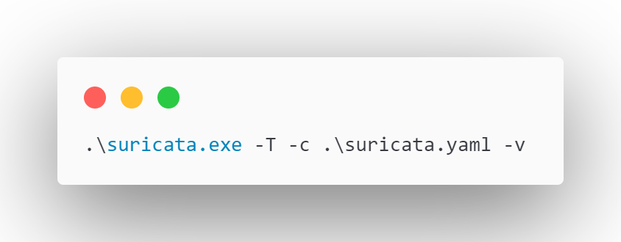
Best Practices for Suricata
Run Suricata as a service & enable IPS mode
Enable Live-Reload to automatically reload configuration without manually restarting
Run Suricata in test mode to validate configuration
Sources:
https://suricata.readthedocs.io/en/suricata-6.0.4/

Slide 11
Active Directory
Duplicati
Restrict the use of Domain Admins & Privileged Groups
Remove unused services
Regular backups via schedule runs
Offsite storage (eg cloud)
Encrypt backup data by default
Set a retention policy
Sources:
https://learn.microsoft.com/en-us/windows-server/identity/ad-ds/plan/security-best-practices/best-practices-for-securing-active-directory
Sources:
https://duplicati.readthedocs.io/en/latest/

